Slide 1
New Sampling Methods to Supplement PIT Detection of Juvenile Salmonids at Bonneville Dam
Background and design prototypes for improving detection efficiency
NOAA NWFSC

Slide 2
Background
A need for increased PIT detection at Bonneville Dam to improve hydrosystem survival estimate precision
Based on estuary PIT Trawl detections, Bonneville Dam detection efficiency has averaged 16% since 2007 and has ranged from 7% to 26%.
New PIT sampling methods being developed in the estuary may be adapted for use at Bonneville to increase detection efficiency without a major site construction effort

Slide 3
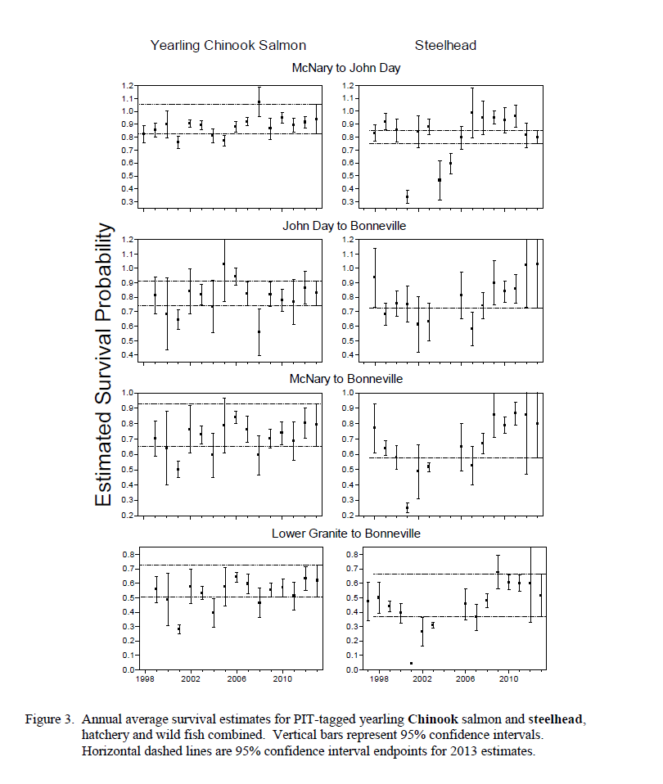
Annual Average Reach Survival Estimate

Slide 4
Flexible PIT Antenna Technology
Detection area of 8x20 ft multiplied by 12 antennas with spacing = >2000 ft
Modular arrays allow for easy replacement of problem antennas
Currently used in both stationary towed applications in the estuary
Small diameter hose (1 in) has minimal drag and sheds debris well

Slide 5
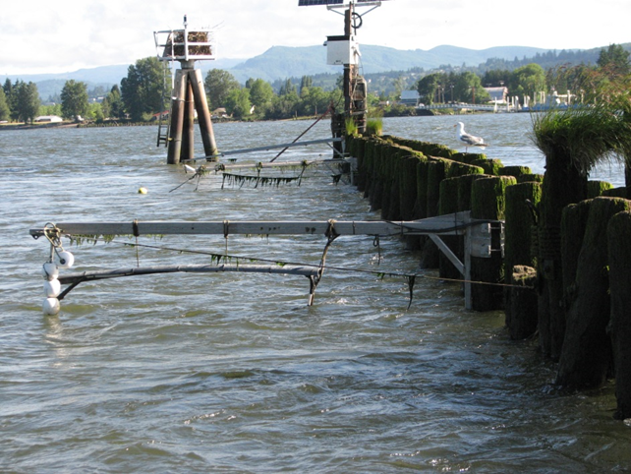
Current Applications - Stationary
Array attached to a pile dike
Structures are attached to individual pilings, then the antennas are attached to them using spreaders to maintain shape

Slide 6
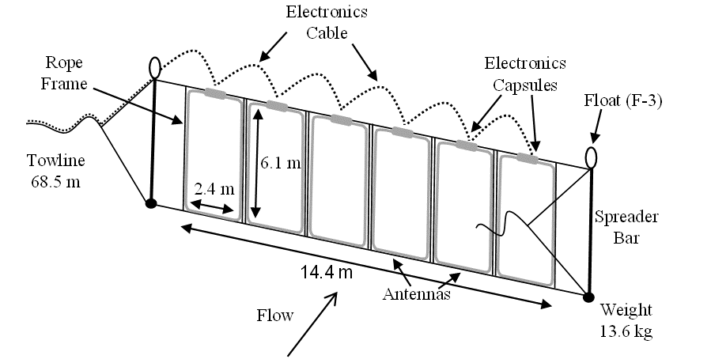
Current Applications - Towed
Spreader bars maintain antenna shape and dynamic tuning function maintains antenna functionality

Slide 7
Current Applications - Towed
Spreader bars maintain antenna shape and dynamic tuning function maintains antenna functionality

Slide 8
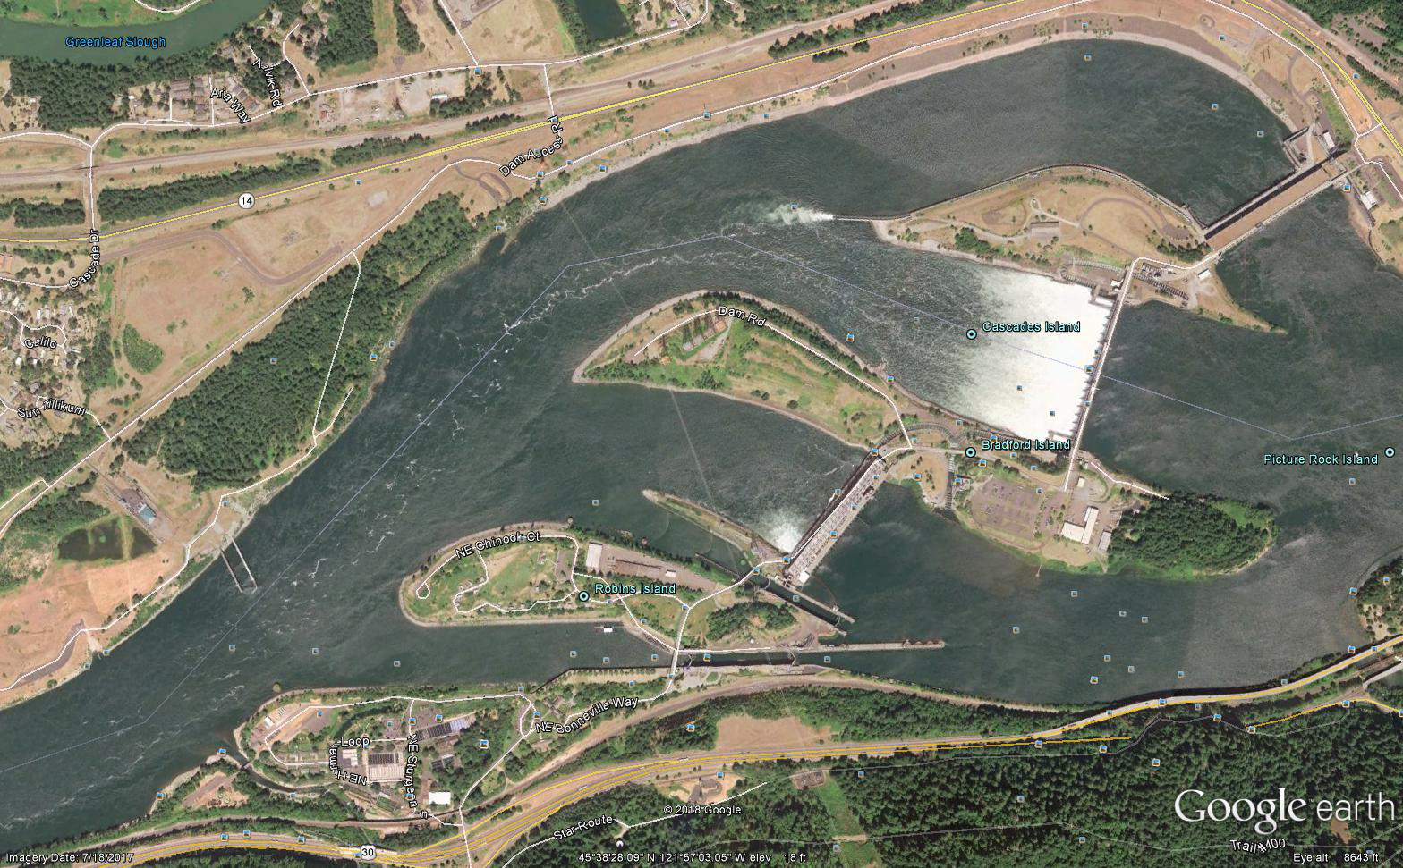
BON Tailrace

Slide 9
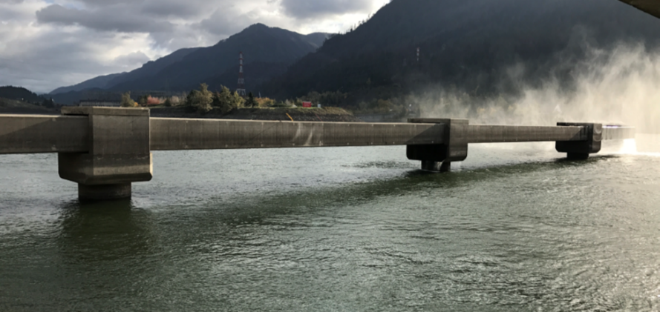
Adapting Technology for Use at Bonneville Dam
Utilize JBS outfall structure for antenna attachment
Currently two prototype arrays under consideration
    1. Modified stationary deployment with antennas in the shadow of the footings
    2. Modified towed deployment with footings acting as anchor points for towlines

Slide 10
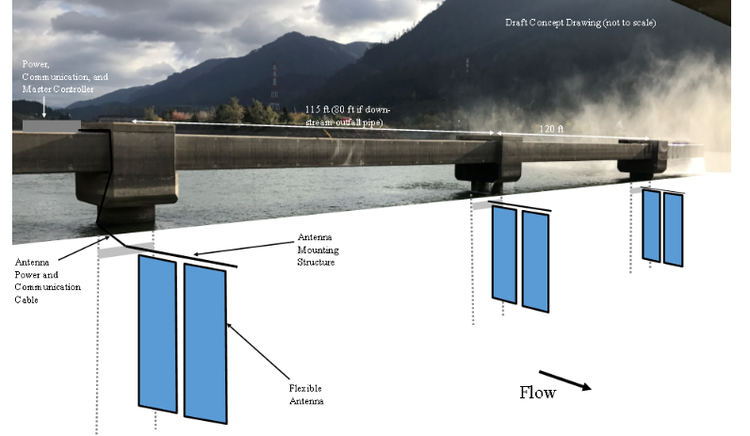
Modified Stationary Deployment
Advantages
Shielded from most debris
If one antenna is taken out by debris, the remaining antennas continue to function
Disadvantages
Smaller detection area
parallel to flow (less efficient for detecting juveniles)
Not accessible during high-water events
Requires installation/use of mounting structures, which could be vulnerable to debris

Slide 11
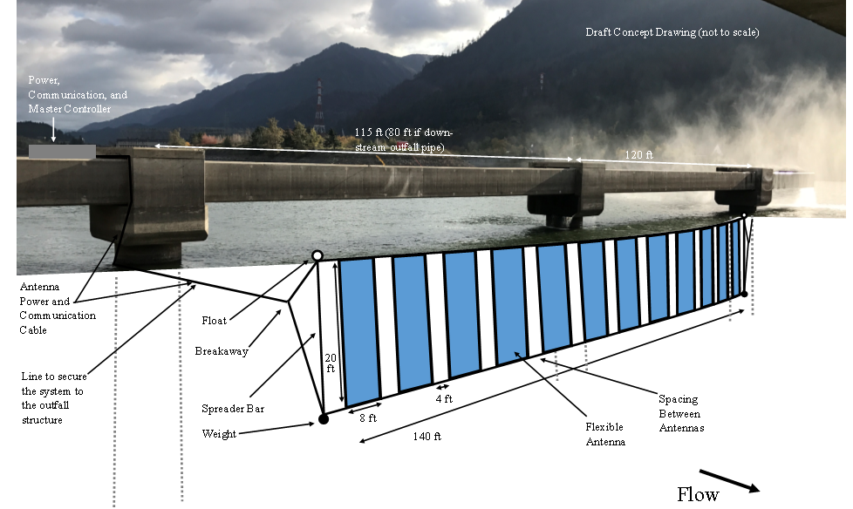
Modified Towed Deployment
Advantages
Largest detection area
Simple Attachment/ Deployment
Can adjust the array laterally
Accessible at all flow levels
Perpendicular to flow
Disadvantages
Susceptible to debris accumulation
System will not function if one attachment point breaks away (attachment point would have to be restored to resume functionality)

Slide 12
Conclusion
Increased detection efficiency at Bonneville Dam is desired. We can use new technology to accomplish this without requiring site construction.
Flexible antennas are versatile and can be used in a variety of array types. Two arrays are presented here, but others can and should be considered.
Managing debris is a major factor in the success of an array at this location.
The site and environment will be assessed during the 2018 spring outmigration period with the intent of deploying a system in 2019.

